Slide 1
ACT Analysis (2017-2019)
Notes:
Adult Changes in Thought (ACT).
The ACT is mandatory in several states, which can lead to higher participation rates and a more comprehensive dataset for analysis.

Slide 2
"ACT test situation in the US? "
First Question: What is the current state of the ACT test in the U.S? The likelihood of taking it, overall, reflects the quality of the score.
Problem Statement
ACT participation rates vary a lot across different U.S. states. Some states require the test, while others don’t, and this affects both test scores and how students perform overall. Looking at these trends by year and region can help us understand the reasons for participation drops and how they might relate to college readiness. Comparing ACT participation with SAT rates could also give more insights and help improve participation in areas where it’s decreasing.
Notes:
Audience

Slide 3
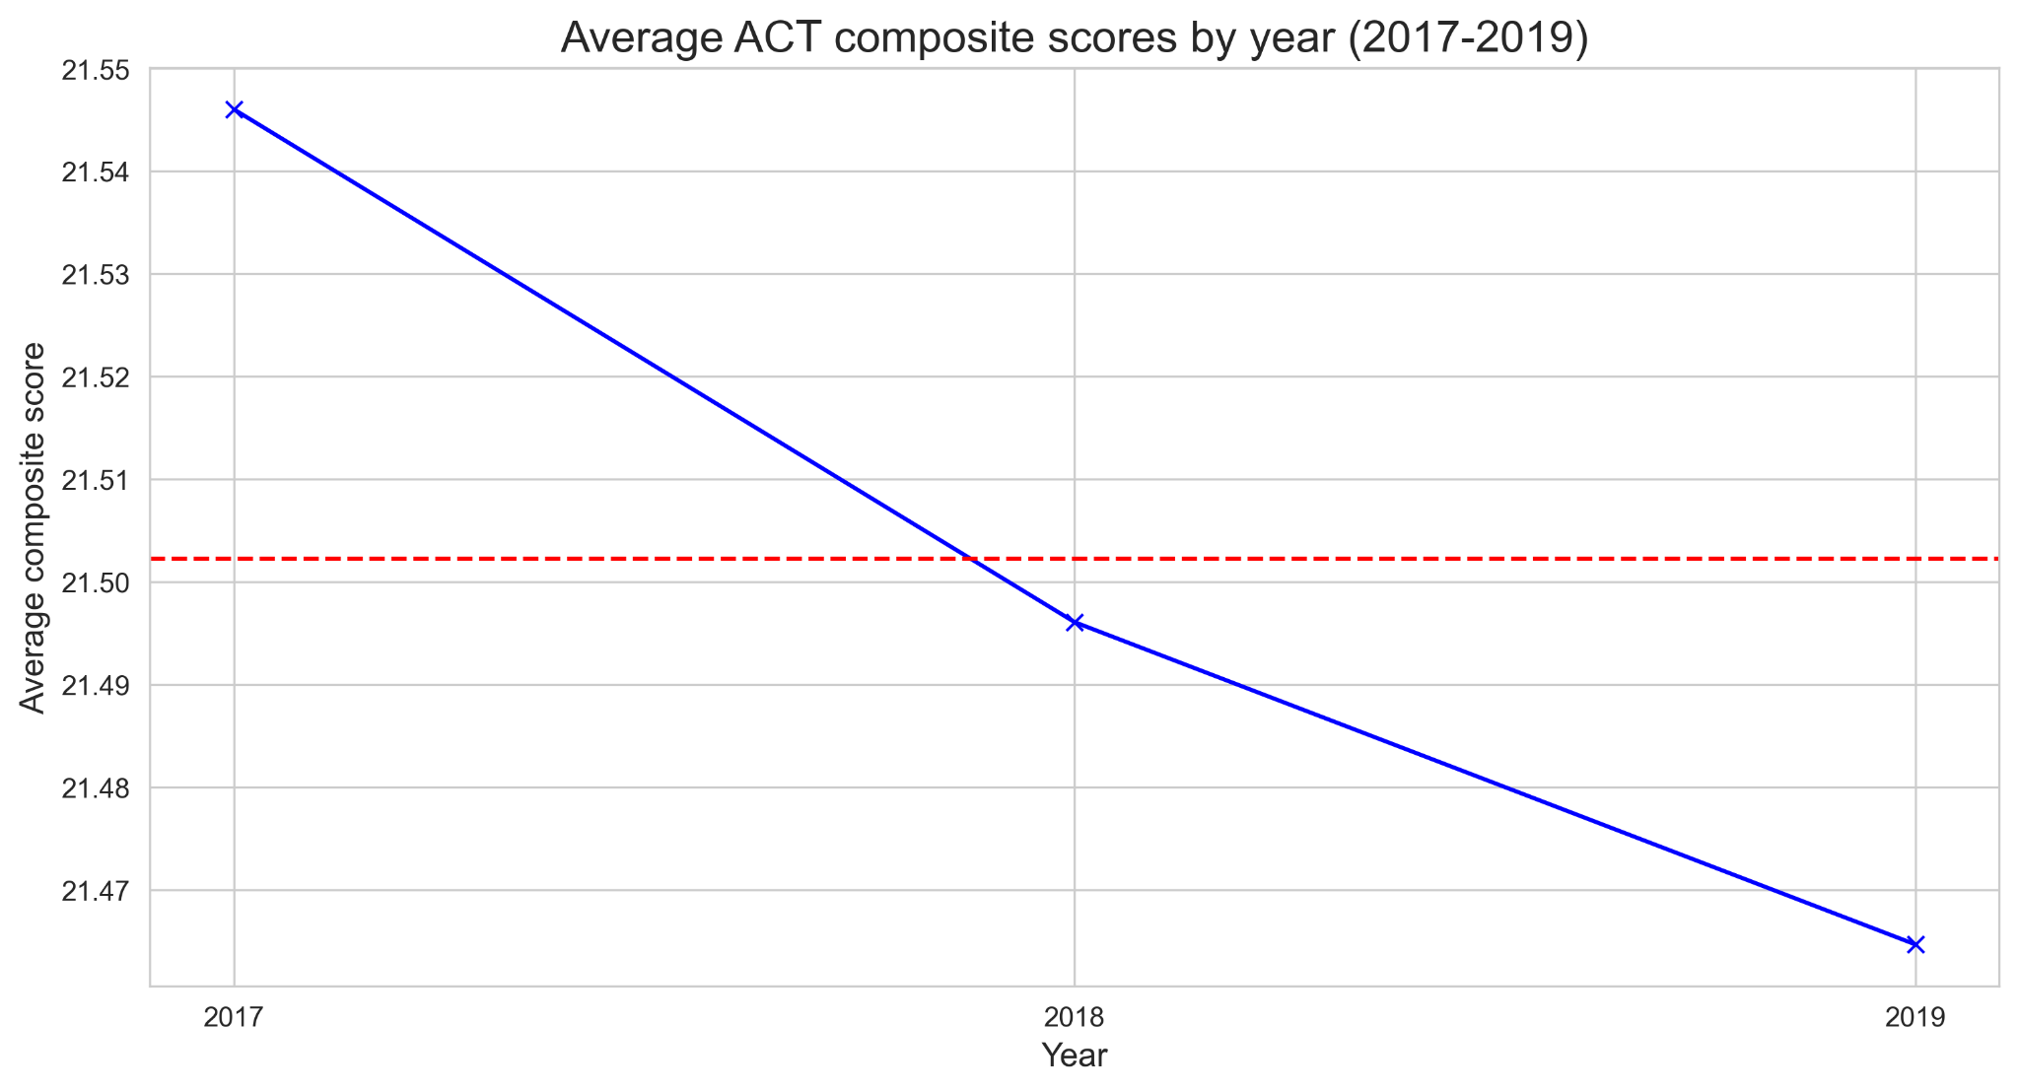
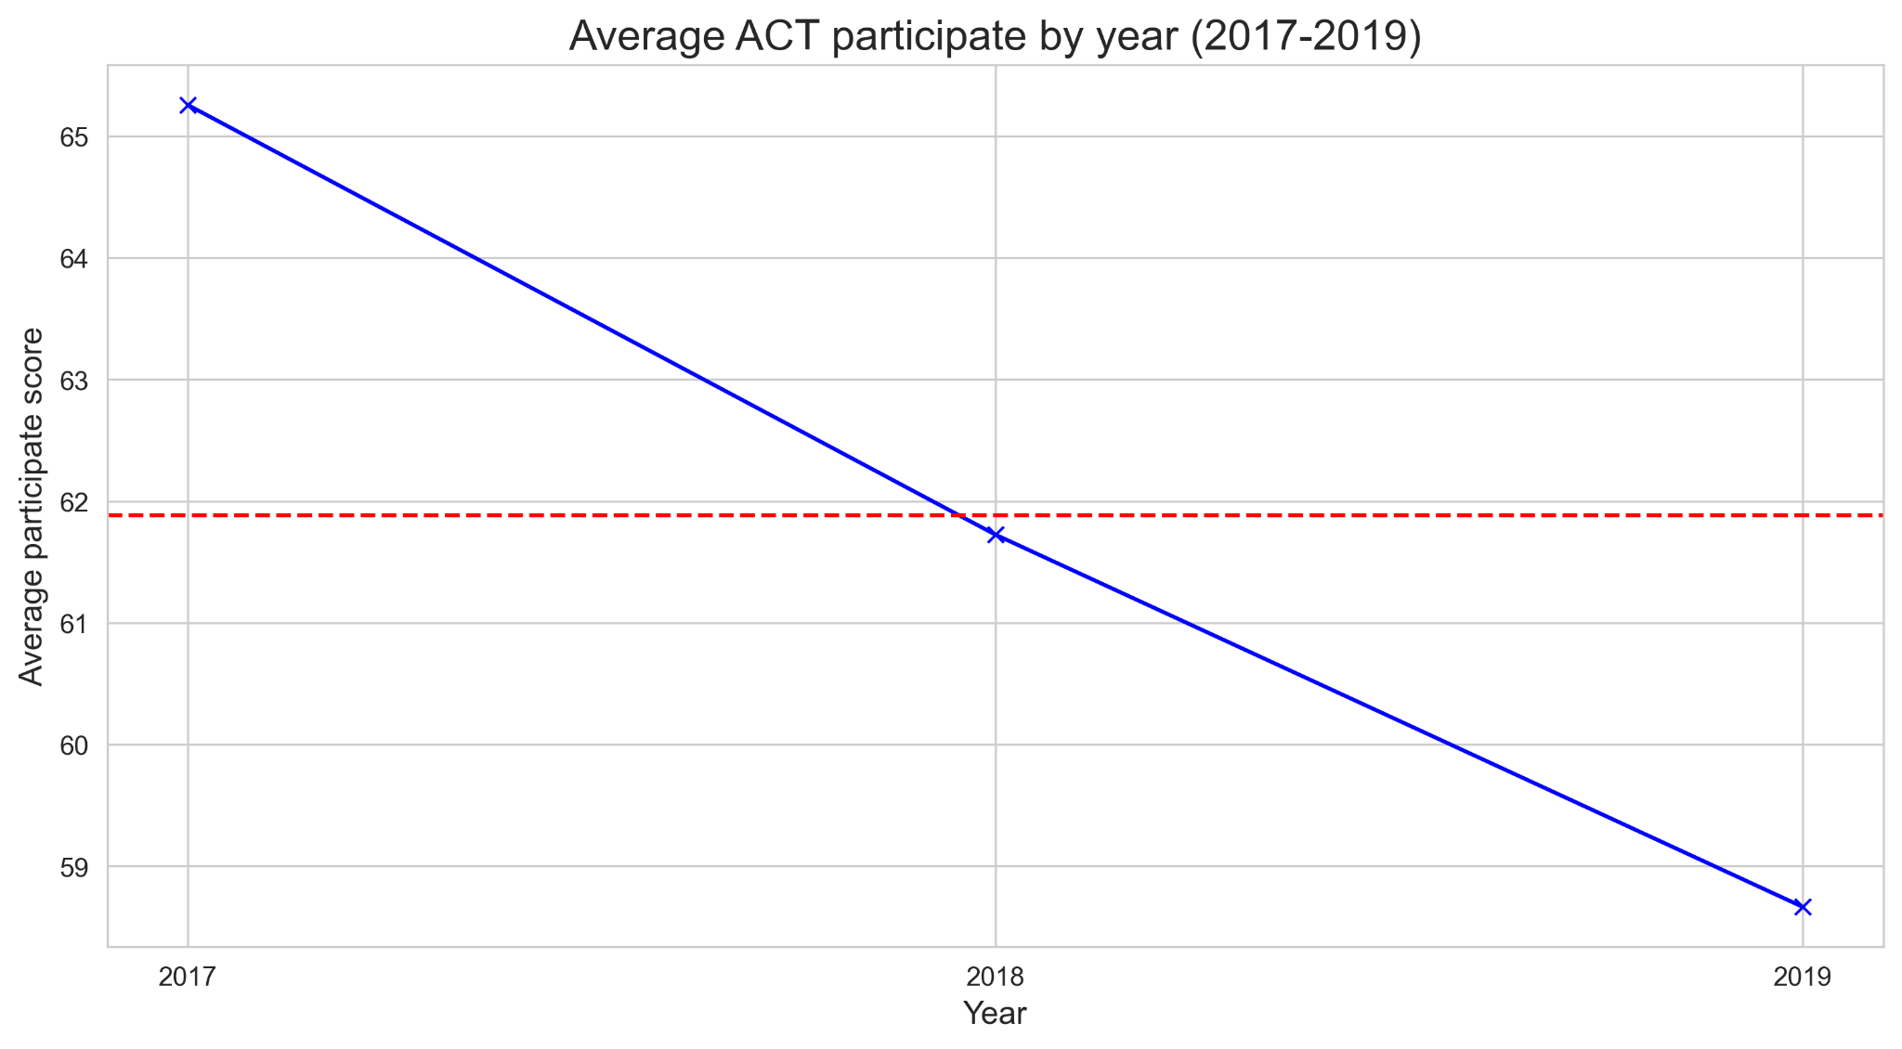
Average ACT composite/participation by year
Notes:
Did you see the trend on the graph it show the same way of decrease but the insight data show the negative relationship
The graphs aim to highlight trends in both metrics, and it’s important to interpret the data accurately. Further analysis is needed to understand the factors contributing to these changes and how significant they are in practical terms.

Slide 4
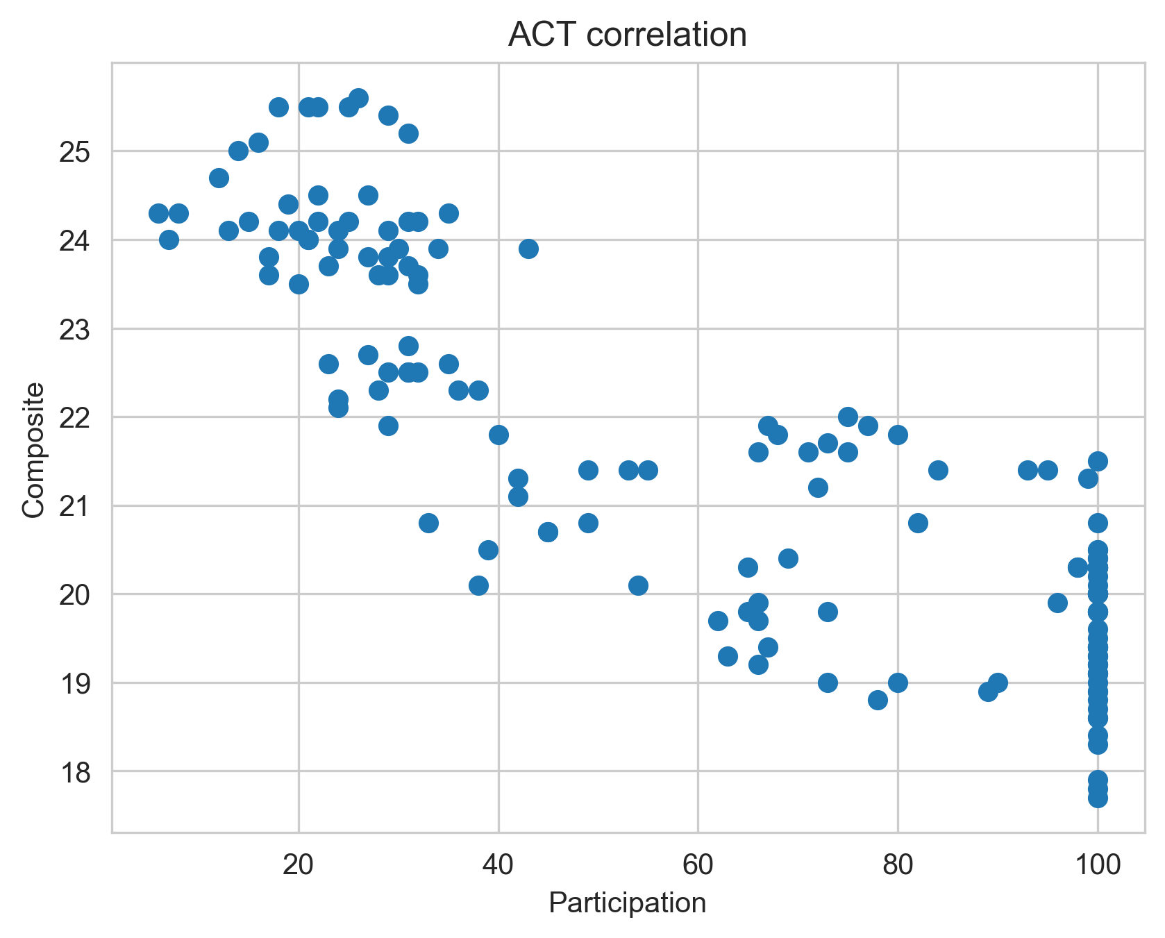
ACT correlation composite and participation
Notes:
-0.8594602116733696

Slide 5
ACT participation and composite scores
High Participation, Lower Scores: The average composite score can be lower in states or years with higher rates of participation.
Low Participation, Higher Scores: On the other hand, states or years with lower rates of participation may have average composite scores that are higher.
Notes:
Negative relation

Slide 6
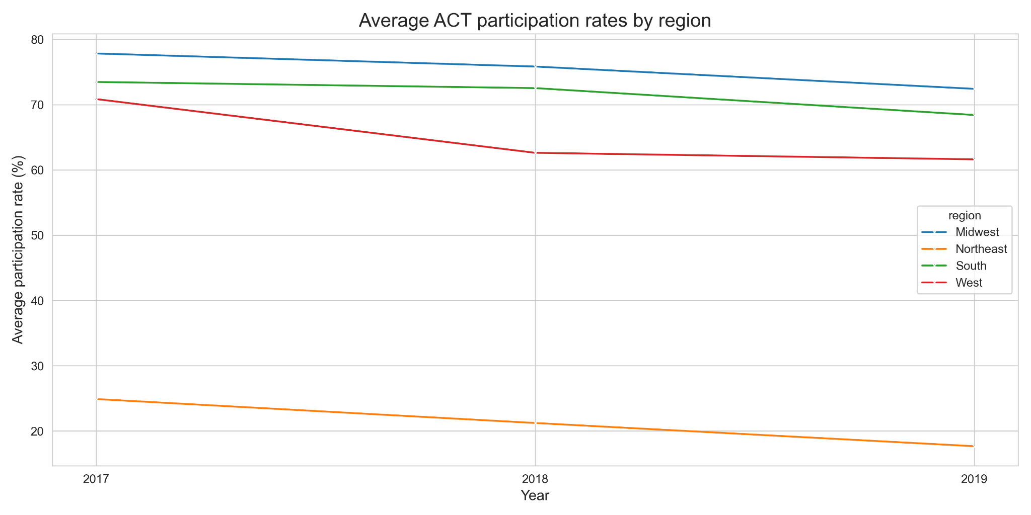
Average ACT participation rates by region
Notes:
Do you see the trend by region

Slide 7
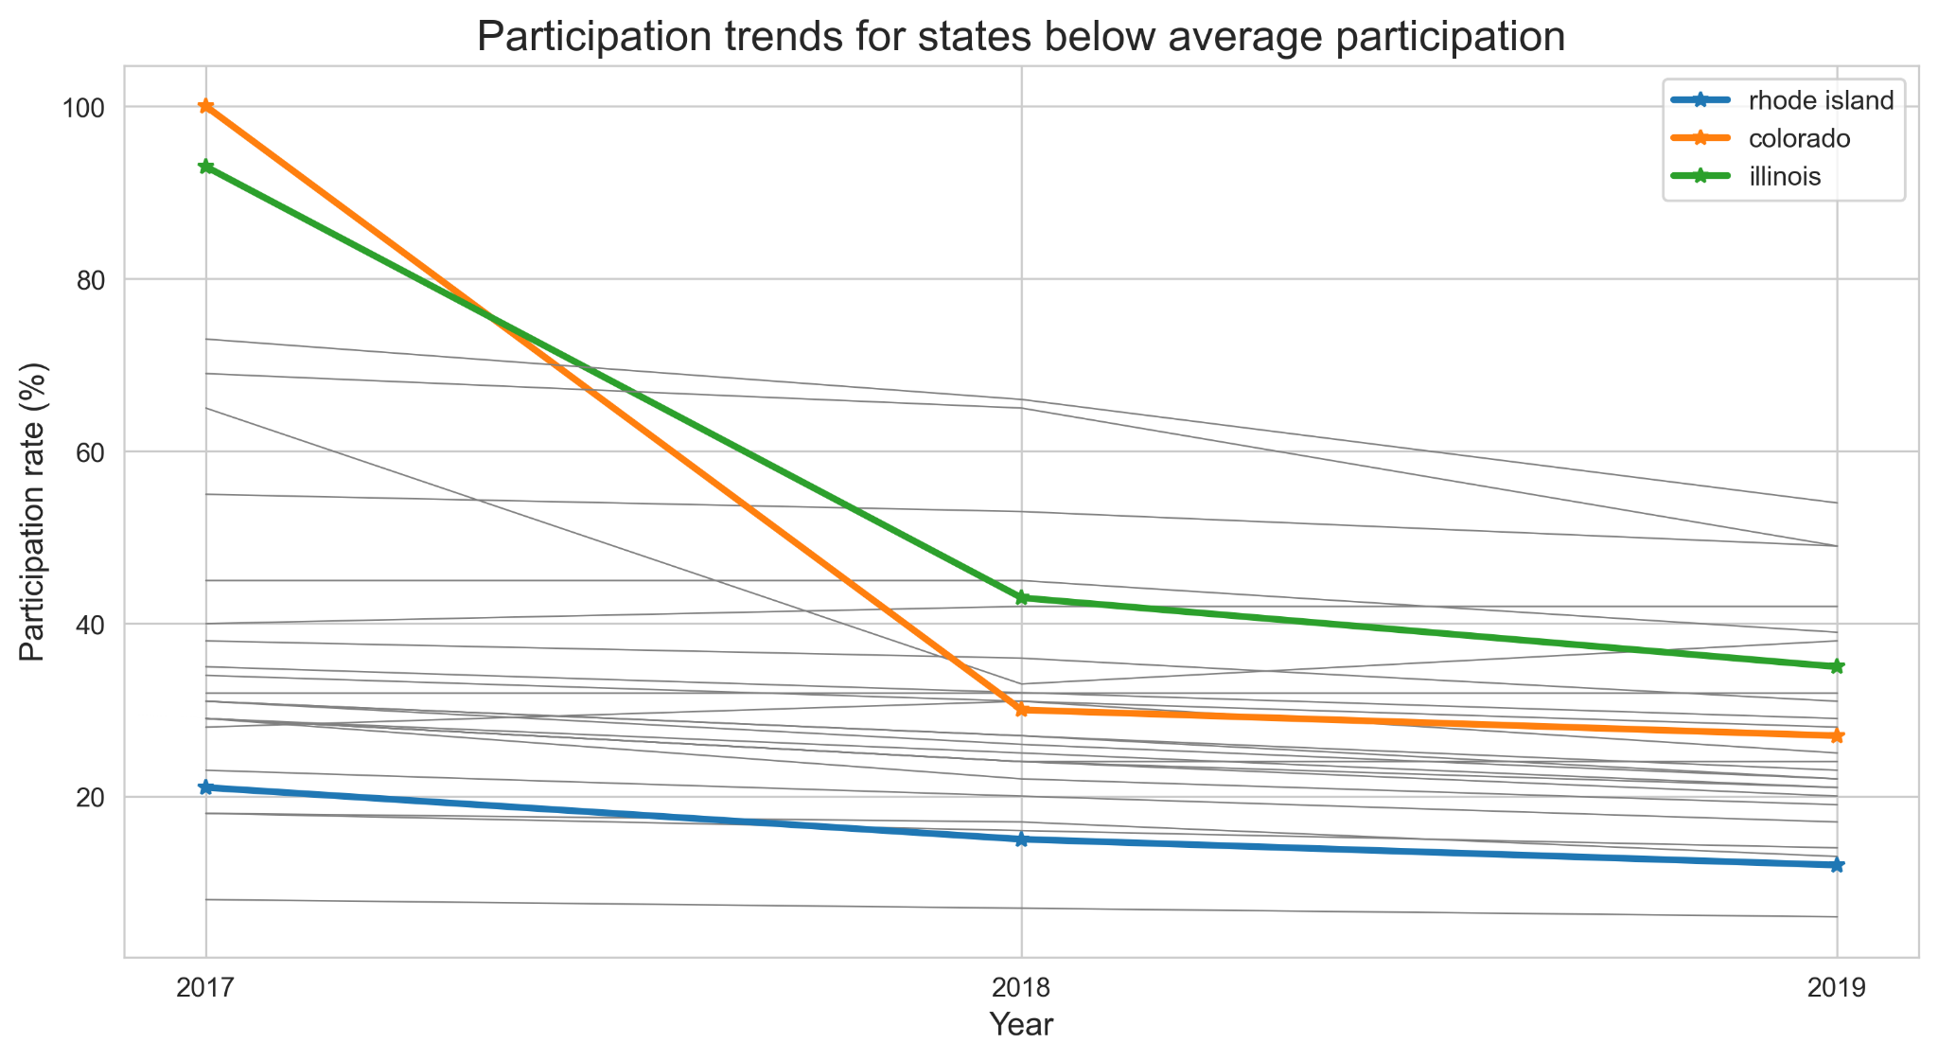
Significant decrease in participation rate
Colorado
Illinois
Rhode Island

Slide 8
Is it the same region?
State : Colorado
Region : West
State : Illinois
Region : Midwest
State : Rhode Island
Region : Northeast
Notes:
The answer is no it take more time to deep dive into the lake of data to find out in each state…

Slide 9
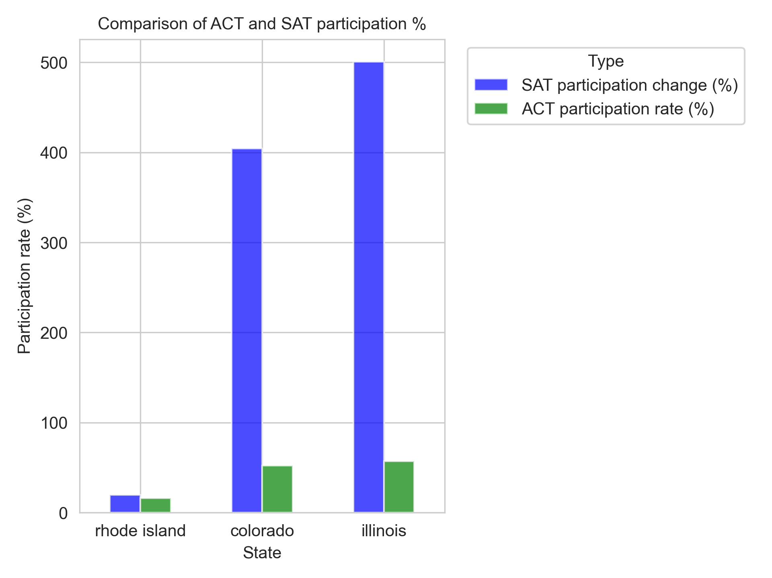
Comparison of ACT and SAT participation
Notes:
rhode island 19.856251 Colorado 404.545455 Illinois 500.505051
Significant increase in participation rate of SAT in 2 states, but the data notices that the participation rate in rhode Island is less for 2 types of tests and we need to be concerned about why.

Slide 10
Next steps to gain further insight
Collect more information.
Colorado made the ACT mandatory for high school students starting in 2001. However, this changed in 2017 when Colorado switched to requiring the SAT, though the ACT remained available as an option.
Colorado’s Switch from ACT to SAT
Illinois finalizes decision to switch from ACT to SAT
Illinois Finalizes Decision to Switch From ACT to SAT
A deeper analysis is recommended to investigate the specific reasons behind declining participation rates in regions with historically high participation. This analysis should focus on how changes in educational policy, economic conditions, and test perceptions are shaping these trends. For example, one question to consider is: Why does accounting, a major that typically doesn't require advanced science knowledge, require a science score from the ACT?

Slide 11


